Slide 1
The role of the assessment system in the relation between learning and performance
Rob Kickert¹,
Karen Stegers-Jager²,
Marieke Meeuwisse¹,
Lidia Arends^{1,3},
Peter Prinzie¹
¹Department of Psychology, Education & Child Studies (DPECS)
²Institute of Medical Education Research Rotterdam (IMERR)
³Department of Biostatistics, Erasmus MC

Slide 2
A possible solution for disappointing academic progress: Renewed assessment system
 | Old system | New system
Consequences (AD-policy) | 40 EC’s BA1 within 1 year, 60 EC’s within 2 years | 60 EC’s BA1 within 1 year
Performance standard/ Compensation | 5.5 conjunctive | 6.0 compensatory (2 x 5.0 – 5.49 permitted)
Notes:
Let op: bij GNK werden studenten met <40 ECTS niet automatisch weggestuurd. Alleen studenten die niet voldaan hadden aan de studiebegeleidingsverplichting werden weggestuurd, de rest mocht het nog een jaar proberen. (maar nog geen 2e jaars vakken doen)

Slide 3
Model SRL, participation & Performance
Stegers-Jager et al. (2012)
Notes:
Model van eerstejaars prestaties voor cohort 2008 op Kennis & Inzicht-toetsen

Slide 4
Methods
Setting:
Erasmus MC medical school, old (conjunctive) assessment
system vs. new (compensatory) assessment system
Participants:
2 cohorts first-year conjunctive students (N = 648)
vs. 2 cohorts first-year compensatory-students (N = 529)
Instrument:
8 subscales Motivated Strategies for Learning Questionnaire (MSLQ^{1;2})
+ items on participation³
+ average grade for 9 first-year tests (≥7 grades)³
Analyses:
Mean differences: MANOVA
Structural model:
Multi-group Structural Equation Modelling
¹Pintrich et al., 1993
²Blom & Severiens, 2008
³Stegers-Jager, Cohen-Schotanus & Themmen, 2012
Notes:
Onderwijsprogramma EMC: The integrated
and theme-oriented curriculum at this school com-
prises a 3-year bachelor degree course followed by a
3-year masters degree course. The first year of the
Bachelor of Medicine is divided into three thematic
blocks of 11–16 weeks, which are organised around
pathophysiological systems and cover subjects, start-
ing from the basic sciences, up to and including
clinical practice. Each study week covers one topic,
such as heart failure, which is dealt with in various
learning activities, including large-group learning
(lectures and patient demonstrations; 8 hours),
small-group learning (skills training and tutorials;
8 hours) and both guided (study assignments;
16 hours) and unguided (8 hours) individual study.
Large-group sessions and guided study assignments
are undertaken on a voluntary basis; for about a
quarter of the small-group sessions student partici-
pation is compulsory. The first year includes nine
written examinations, consisting of open-ended and
multiple-choice questions.

Slide 5
RQ1: mean differences in SRL, participation and performance?
4.66 < 4.89
4.27 < 4.60
4.63 < 4.91
6.06 < 6.57
5.77 < 5.93
Year 1 average grade
4.91 < 5.33
4.89 < 5.08
Legend:
- Old
- New
- Significant
difference
4.69 < 4.78
4.58 < 4.84
Notes:
Are mean self-regulated learning, participation and performance different under the new assessment system, compared to the old system?

Slide 6
RQ2: similar structural relations?
Model fit:
χ² = 354.835,
CFI = .947,
SRMR = .048,
RMSEA = .044
* p < .001; † p < .05
Notes:
RQ 2: Have the relations between self-regulated learning, participation and performance (as described by Stegers-Jager et al. (2012)) remained the same under the new assessment system?

Slide 7
Conclusions
Are mean SRL, participation and performance different under the new assessment system, compared to the old system?
A. Higher grades under N=N:
assessment drives learning (operant & cognitive)
B. Motivation, learning strategies & participation generally higher under new assessment system
Have the relations between SRL, participation and performance remained the same under the new assessment system?
Similar associations under both assessment systems
→ Same behavior is related to performance
Overall: Higher performance not explained by different relations,
but by higher SRL & participation
Notes:
1A
→ Hoe tactisch zijn geneeskundestudenten? (6.0 vs. 5.5)
→ Wat zou er gebeuren als de eis verder opgehoogd wordt?
→ Hoe verhoudt dit zich tot welzijn en stressniveaus?
→ Grade goals?
1B
→ extrinsieke motivatie tóch niet schadelijk voor intrinsieke motivatie?
→ Doelen onder N=N wellicht specifieker (alle 60 EC) en moeilijker, dus motiverender?
→ Alleen verhoging in constructen die studenten noodzakelijk achten voor goede cijfers?
2
Not in line with previous research → high vs. higher stakes?

Slide 8
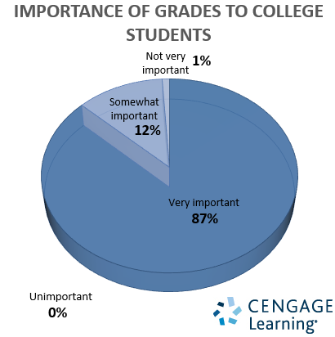
In short
Never underestimate the power of testing

Slide 9

Questions?
r.kickert@fsw.eur.nl

Slide 10
References
Blom, S., & Severiens, S. (2008). Engagement in self-regulated deep learning of successful immigrant and non-immigrant students in inner city schools. European Journal of Psychology of Education, 23, 41–58. doi:10.1007/BF03173139
CBS (2014). WO: studievoortgang, vooropleiding, studierichting, herkomstgroepering. Retrieved from http://statline.cbs.nl/.
Credé, M., Roch, S. G., & Kieszczynka, U. M. (2010). Class Attendance in College A Meta-Analytic Review of the Relationship of Class Attendance With Grades and Student Characteristics. Review of Educational Research, 80, 272–295. doi:10.3102/0034654310362998
Pintrich, P. R., & de Groot, E. V. (1990). Motivational and self-regulated learning components of classroom academic performance. Journal of Educational Psychology, 82, 33–40. doi:10.1037/0022-0663.82.1.33
Pintrich, P. R., Smith, D. A. F., Garcia, T., & Mckeachie, W. J. (1993). Reliability and Predictive Validity of the Motivated Strategies for Learning Questionnaire (Mslq). Educational and Psychological Measurement, 53, 801–813. doi:10.1177/0013164493053003024
Schmidt, H. G., Cohen-Schotanus, J., Van der Molen, H. T., Splinter, T. A. W., Bulte, J., Holdrinet, R., & Van Rossum, H. J. M. (2009). Learning more by being taught less: a “time-for-self- study” theory explaining curricular effects on graduation rate and study duration. Higher Education, 60, 287–300. doi:10.1007/s10734-009-9300-3
Stegers-Jager, K. M., Cohen-Schotanus, J., & Themmen, A. P. N. (2012). Motivation, learning strategies, participation and medical school performance. Medical Education,
46, 678–688. doi:10.1111/j.1365-2923.2012.04284.x

Slide 11
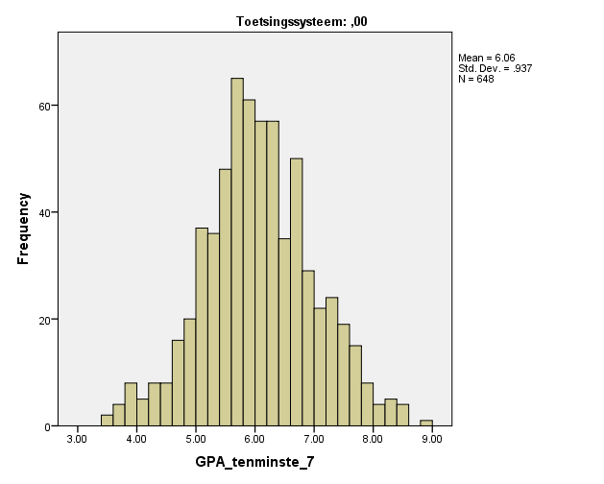
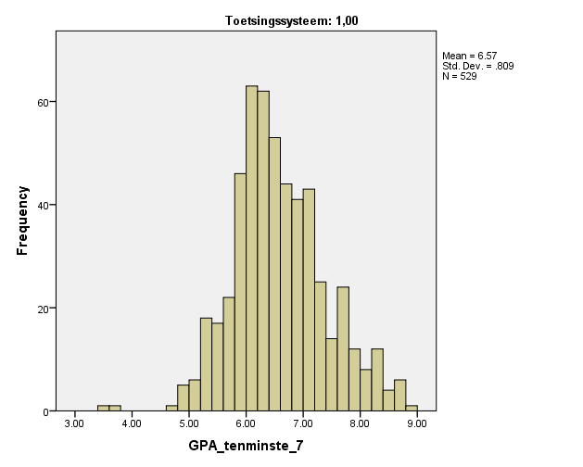
The strategic student?
r_{assessmentsystem-average grade} = .28
Old (conjunctive)
New (compensatory)
Average grade
M = 6.06,
sd = .937
N = 648
73.8 % ≥ 5.5
Average grade
M = 6.57,
sd = .809
N = 529
77.9% ≥ 6.0

Slide 12
Example items
Construct | Example item
Task value | I am very interested in the content area of this course
Intrinsic goal orientation | In a class like this, I prefer course material that arouses my curiosity, even if it is difficult to learn
Self-efficacy | I expect to do well in this class
Elaboration | I try to relate ideas in this subject to those in other courses whenever possible
Organisation | I make simple charts, diagrams, or tables to help me organize course material
Metacognition | Before I study new course material thoroughly, I often skim it to see how it is organized.
Effort regulation | I work hard to do well in this class even if I don't like what we are doing
Time management | I make good use of my study time for this course
Participation skills training | What percentage of the skills trainings did you attend?
Notes:
MSLQ-items: 7-puntsschaal
Participatie: 5-punts

Slide 13
Raw results
SRL construct | M (sd) Old cohorts | M (sd) New cohorts | P-value | Effect size: Cohen’s d
Value | 5.77 (.73) | 5.93 (.71) | < .001 | .22
Intrinsic goal oriëntation | 5.74 (.73) | 5.79 (.72) | n.s. | -
Self-efficacy | 4.89 (.84) | 5.08 (.80) | < .001 | .23
Metacognition | 4.27 (.80) | 4.60 (.83) | < .001 | .40
Elaboration | 4.85 (.87) | 4.86 (.90) | n.s. | -
Organisation | 4.66 (1.16) | 4.89 (1.23) | .001 | .19
Effort regulation | 4.91 (1.06) | 5.33 (.97) | < .001 | .41
Time- & study-environment management | 4.63 (1.04) | 4.91 (1.01) | < .001 | .27

Slide 14
Raw results
Construct | M (sd) Old cohorts | M (sd) New cohorts | P-value | Effect size: Cohen’s d
Participation lectures | 4.69 (.67) | 4.78 (.62) | .016 | .14
Participation skills trainings | 4.58 (.67) | 4.84 (.47) | < .001 | .45
Participation guided individual study | 4.10 (1.15) | 4.06 (1.18) | n.s.
Average grade | 6.06 (.94) | 6.57 (.81) | < .001 | .57

Slide 15
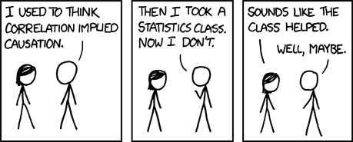
Limitations
- Observational research
- Include early drop-outs?
- Altered selection procedure: 50% weighted lottery
→ 20%

