Slide 1
Blended Learning & Student Success
Dr. Nynke Bos (ICLON)
[CEL Innovation Room #9 ‘Research on Student Success', Rotterdam, The Netherlands]

Slide 2
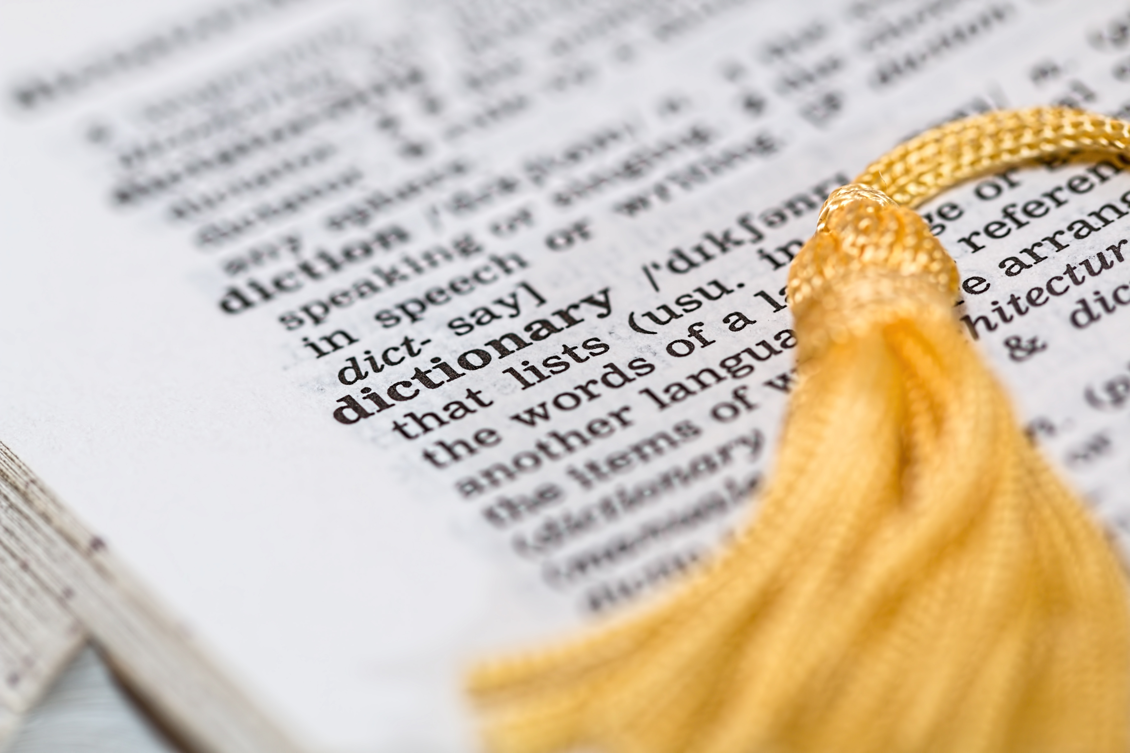
What is blended learning?
Notes:
Uitleggen wat BL is. Dat er veel definities zijn en welke er in mijn onderzoek gebruikt is en waarom

Slide 3
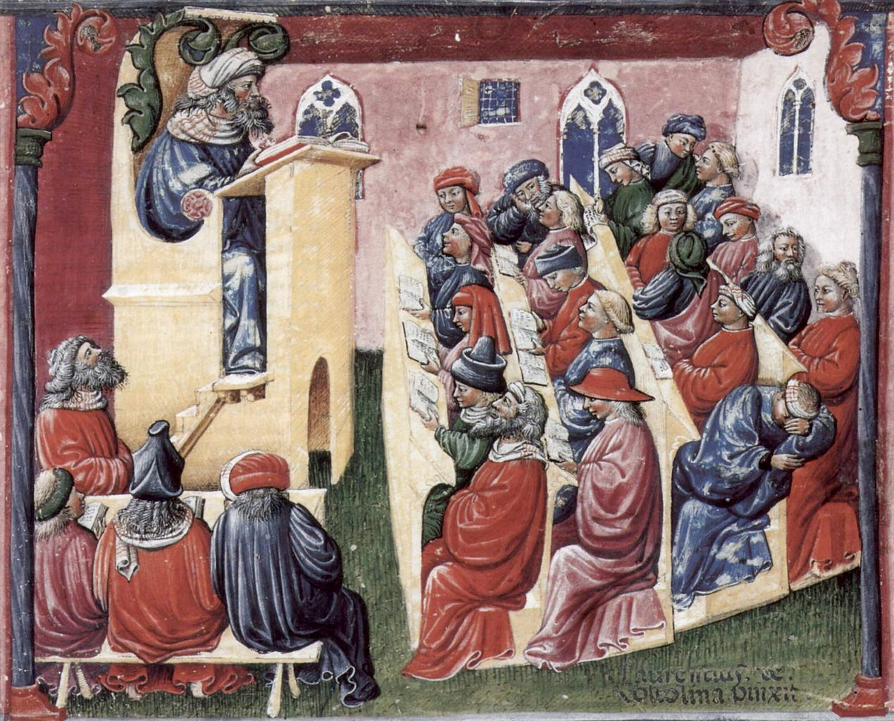
Why this research?
Notes:
Uitleggen waarom ik dit onderzoek ben gestart: Wat werkt voor wie waarom? Beter beleidsmatig BL ontwerpen. Data informed policy

Slide 4
Evidence informed education
Notes:
Hoe heb ik dit onderzocht? Welke data heb ik verzameld?

Slide 5
Loves attending lectures
Average use of learning resources (besides..)
Doesn’t attend lectures
Average use of other learning resources
Uses recordings as substitute for attendance
Above average use of other learning materials
No-users
Notes:
Cluster op basis van leermaterialen

Slide 6
Loves attending lectures
Average use of other learning resources (besides)
External regulation
Low self-efficacy
”Will this be assessed?”
Does not attend lectures
Average use other learning resources
Not a clear approach to learning
Uses recordings as substitute
Above average use of learning resources
Self-regulated
Dislikes peer-learning
I don’t need anything
High self-efficacy
Do I overestimate myself?
Notes:
Cluster op basis van leermaterialen

Slide 7
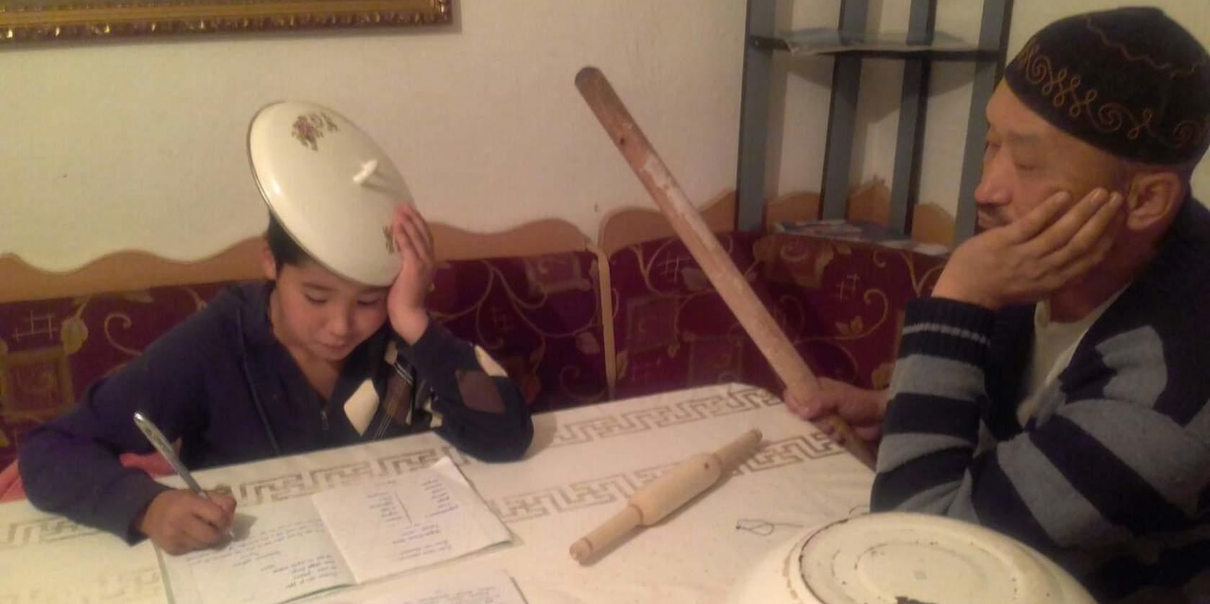
Implications

Slide 8
More info? www.drblend.org

