Slide 1
Designing solutions for a complex world
Unleashing the power of parallel frugality as key to achieve inclusiveness
Paper presentation CFIA Workshop
Den Haag - 26 November 2015
Wouter Kersten & J.C. Diehl

Slide 2
A brief navigation
Core workshop question
Disecting key terms
Current reality in global development
How can we improve?
A next step paradigm
Cases and first results from practice
On collaboration
Checkback: Relevance for this workshop
Moving forward

Slide 3
1. Core workshop question
“How can frugal innovation become more inclusive?”

Slide 4
2. Disecting the terms
Frugal = low resource, good-value propositions for underserved segments (with spin off potential)
Inclusive = strong involvement of underpriviliged target group(s) in the process, and the result to be accessible to as many people in these groups as possible

Slide 5
3. Current reality
‘Globalization’ 1.0: universal solutions
Next phase: context sensitivity, user centred
Downsides:
  Limited reach
  New context = (full) redesign
  Expensive, Long, demotivational
  Impact takes long tiem

Slide 6
4. How can we improve?
Large scale = multiple contexts
= complex, but: complex is not Bad (!!)
Not just multiple stakeholders, but…
… multiform analysis: rich solution space with “shared insights”
Step towards (multiple) solutions

Slide 7
5. A next step paradigm
Cherish complexity, it is reality
Decompose the problem differently
Vary the contextual perspective on purpose
Satisfice instead of optimise
Be prepared to jump & turn, not just step
From contextual to collective intelligence

Slide 8
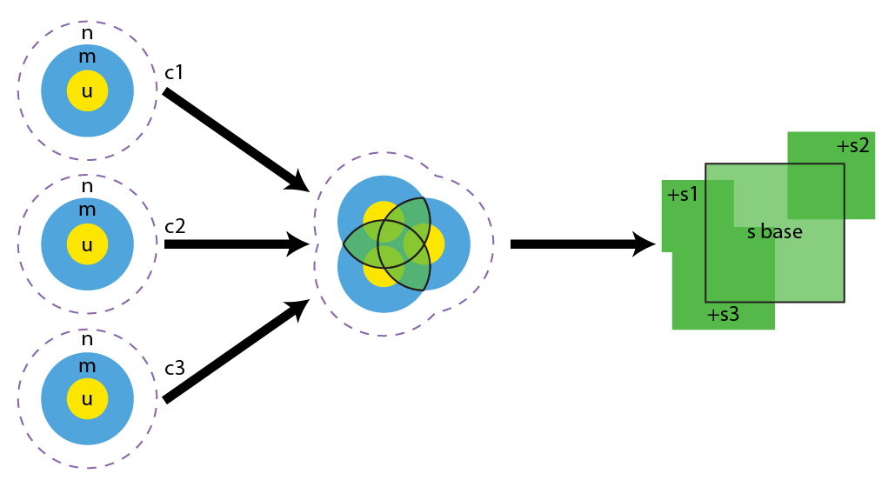
Context Variation by Design (CVD)

Slide 9
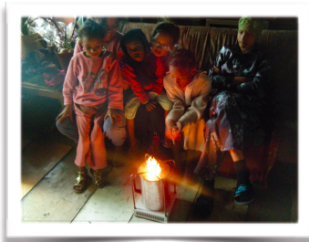
6. First results from practice
External cases:
  WakaWaka
  BioLite
Own cases:
  Mobile sanitation (6)
  Energy sharing (2)
  Biodegradable diapers (3)
  Community facilities (6)
  Gasifiers (> 4)
  Maternal health check (3)

Slide 10
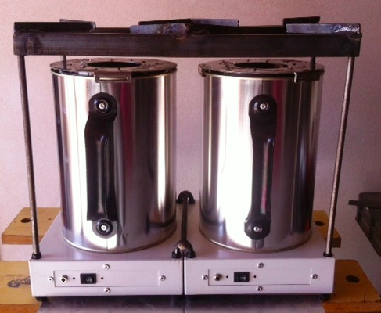
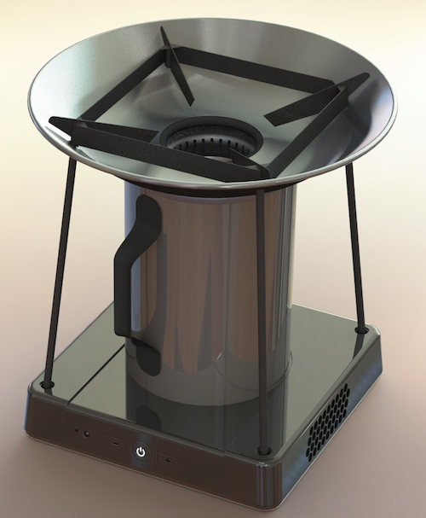
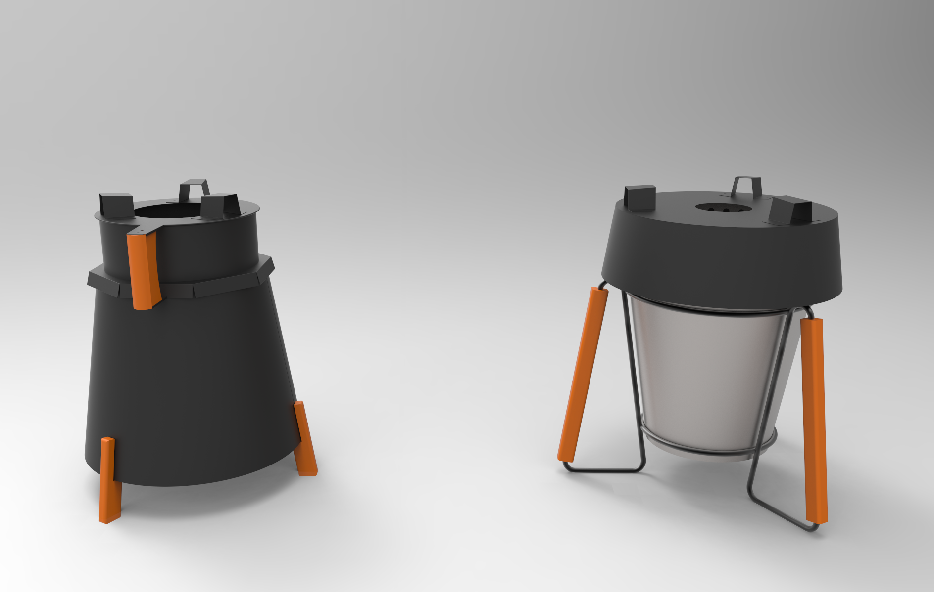

Slide 11
What do “shared insights” add?
Revealing unexpected similarities
Different situations may result in same demand
Making differences explicit
Creativity: combine demands in satisfactory way
Outside perspective: new openings
Variation on other than product level
Multi-context Integral solutions

Slide 12
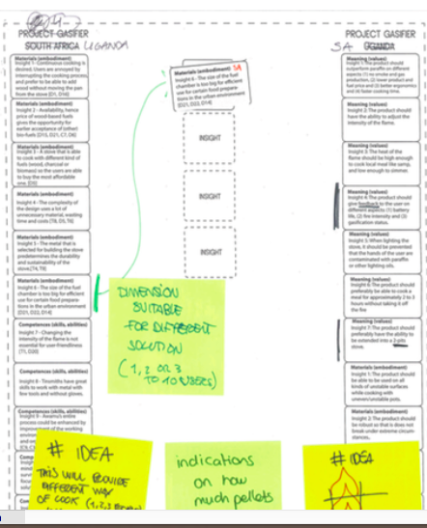
Examples of Shared Insights
Not unique for CVD, but more likely thanks to:
Actual end-user vs. purchasing decision maker
Allow for different size families (‘future proofing’)
Incentives vary for different target groups
Revenue model influences design
User actions vary, but all “use cues” intuitive

Slide 13
First process lessons from practice
More complex process ≠ complex products!
Creativity and structure
Requirements and context specificty
… different ways to solve that
Contextual boundaries are psychological

Slide 14
7. On collaboration
From teams to orchestra’s
“Musicians” & “compositions”
Variety of partners is necessity
Small and Big
Uniqueness of edges

Slide 15
8. Relevance for this workshop
“Frugal mindset is helpful starting point
Multiple contexts: “Parallel Frugality”
Involving more contexts = involving more (BoP) target groups = more inclusive
Solutions are sooner acccessible to more contexts = more people = more impact

Slide 16
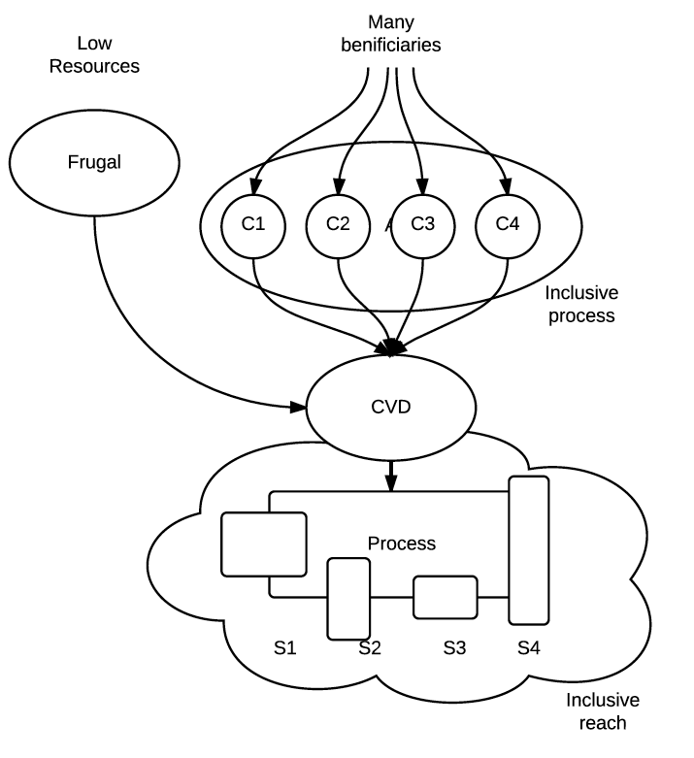

Slide 17
9. Moving forward
Process vs Result focus?
  Quality of Shared Solution Space, intended results will then follow
  Better, quicker, lower overall costs, SSS will take care of itself
Complete cases for “full story”
Application in practice vs. scientific rigour?

Slide 18
… but first it is your turn
What do you think about this approach?
Cases where it would have helped?
Situations where it may work better?
Critique, points of attention?

