Slide 1
Learning Analytics & MOOCs-Data Issues Perspective
Mohammad Khalil
Innovation Room9 09.06.2017

Slide 2
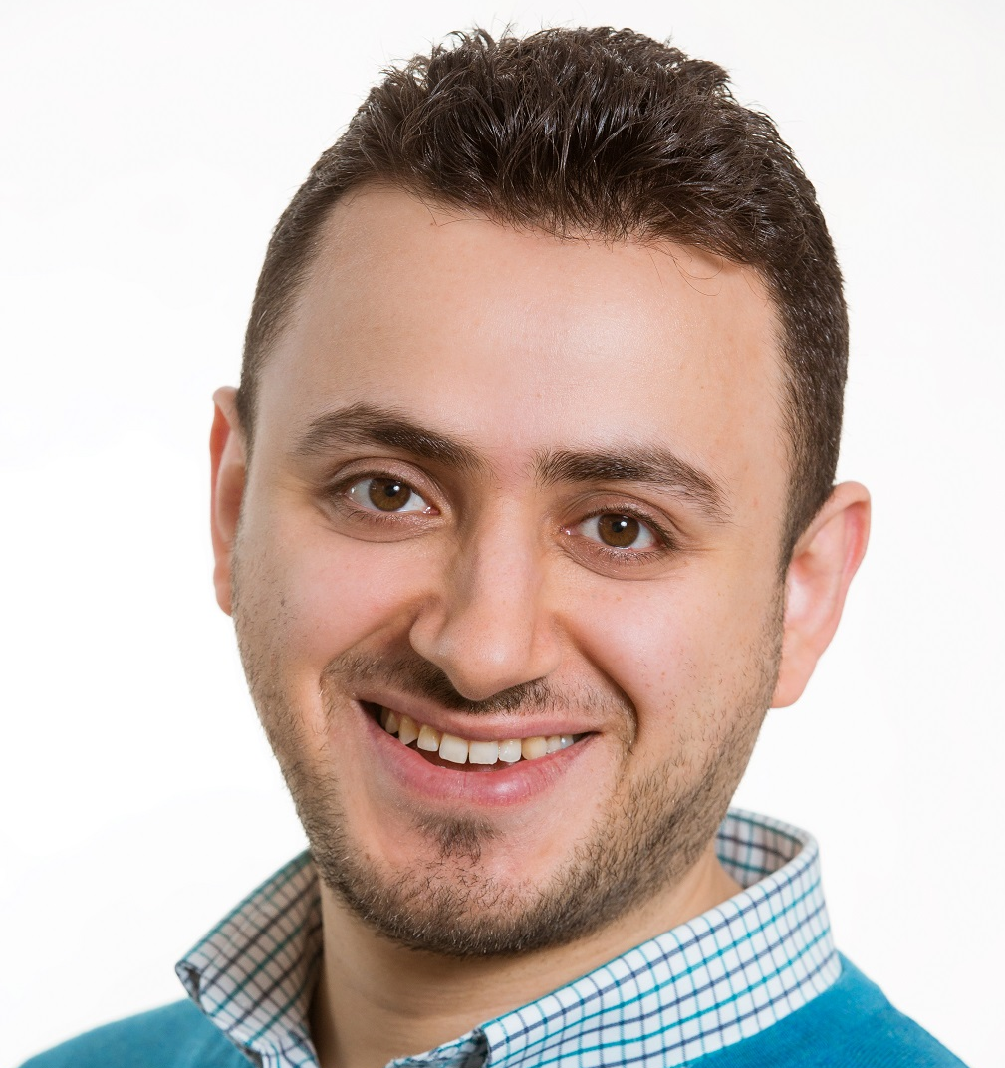


Hello!
I am Mohammad Khalil
@TUMohdKhalil
http://mohdkhalil.wordpress.com

Slide 3

The MOOCs Hype
Image from: Vlad Mihaescu

Slide 4
6,850
58,000,000
Online students
MOOCs

Slide 5

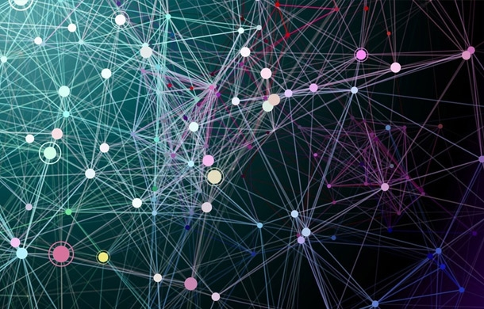

Data & Analytics
MOOC Data
Learning Analytics

Slide 6
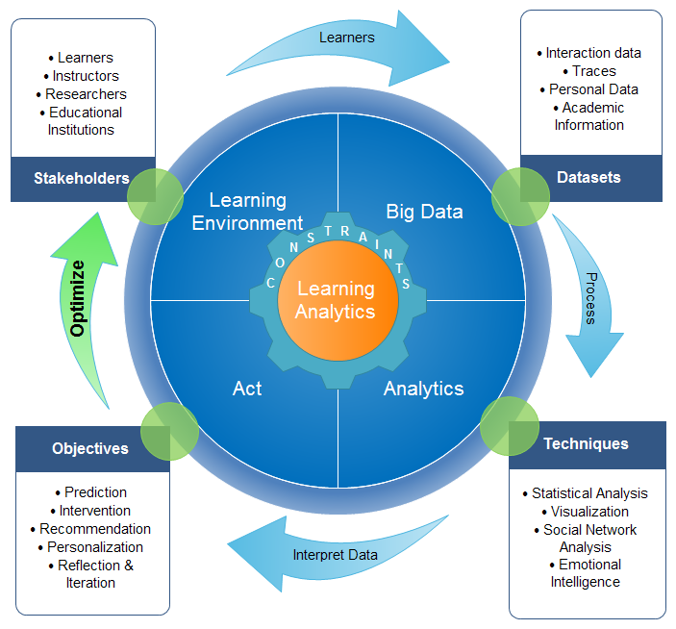
Learning Analytics Lifecycle
Khalil, M., & Ebner, M. (2016). Learning Analytics: Principles and Constraints. In Proceedings of World Conference on Educational Multimedia, Hypermedia and Telecommunications (pp. 1326-1336).

Slide 7
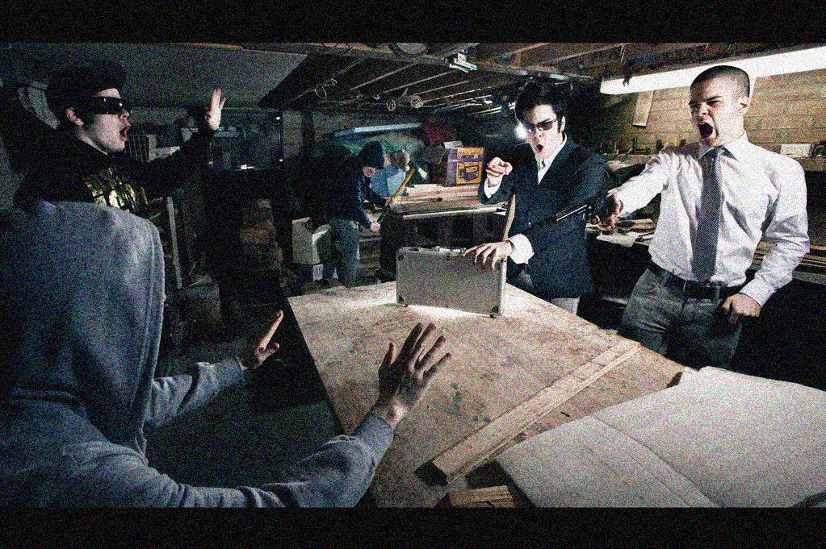
But, What if Learning Analytics goes wrong?
Mistaken Predictions!
Ethical breaches!!!
https://www.flickr.com/photos/thierrylord/4541208666

Slide 8


Learning Analytics
http://www.beyondblackwhite.com/wp-content/uploads/2011/09/thumbs-down.jpg

Slide 9
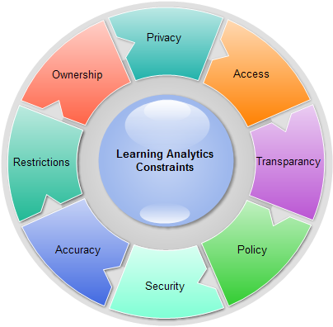
Revealing Personal Information
Morality to view students’ data
Collecting and Analyzing data
Transparency
Students’ data deletion policy
Khalil, M., & Ebner, M. (2016). Learning Analytics: Principles and Constraints. In Proceedings of World Conference on Educational Multimedia, Hypermedia and Telecommunications (pp. 1326-1336).

Slide 10
Who owns students data,
students or institutions?
Data Protection and Copyright
Laws limit the use of LA apps
Inaccurate analysis results?
Achieving Confidentiality, Integrity
and Availability
Khalil, M., & Ebner, M. (2016). Learning Analytics: Principles and Constraints. In Proceedings of World Conference on Educational Multimedia, Hypermedia and Telecommunications (pp. 1326-1336).

Slide 11


Learning Analytics
Personal Information
http://www.moneysense.ca/invest/investors-dont-have-to-wait-for-canada-to-bury-trailers

Slide 12

De - IDentification
Achieve Privacy
Research Reasons
Available to Public
https://www.flickr.com/photos/trois-tetes/5195847/

Slide 13
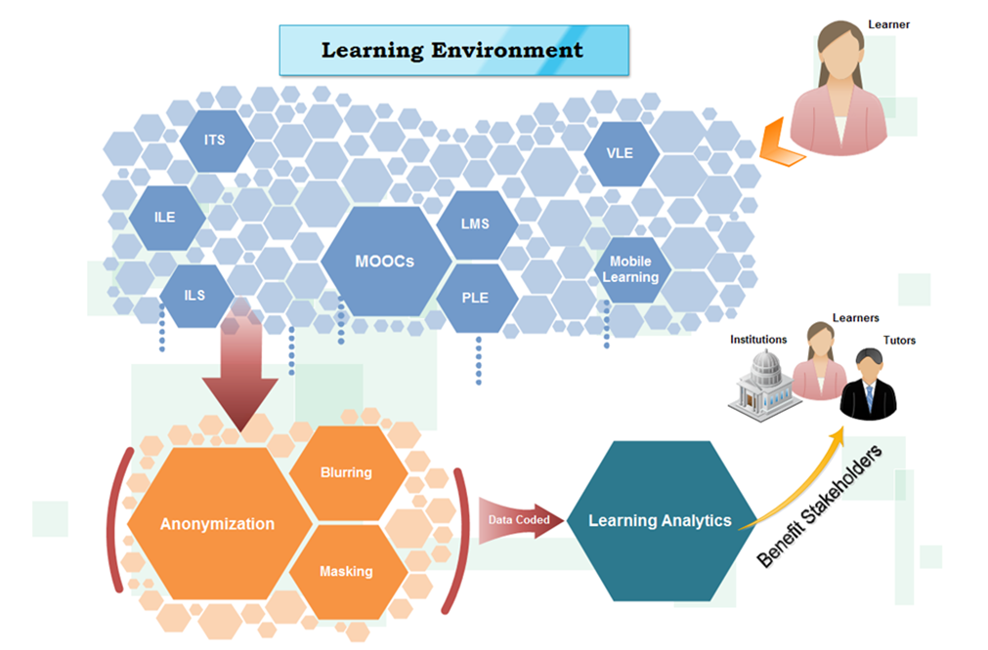
De-Identification Approach
European DPD 95/46/EC
Khalil, M., & Ebner, M. (2016). De-Identification in Learning Analytics. Journal of Learning Analytics, 3(1), pp. 129-138

Slide 14
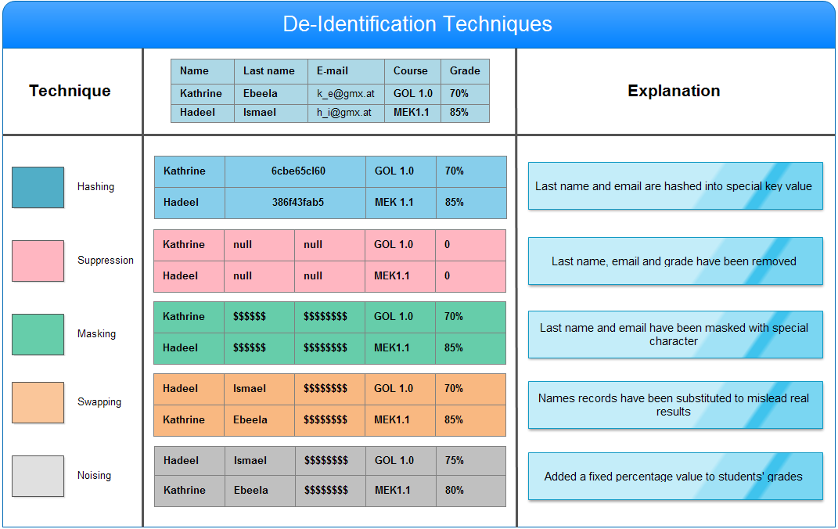

Slide 15
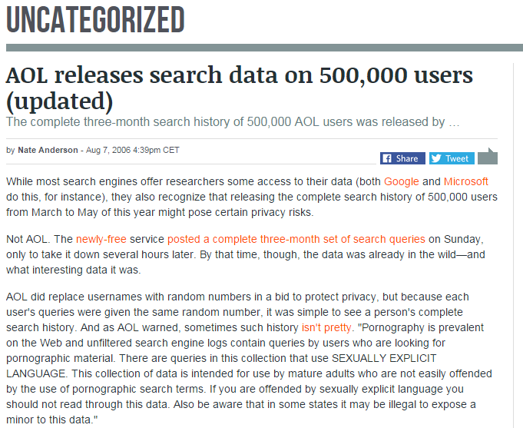
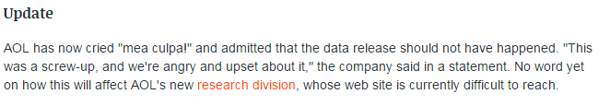

Slide 16
Thank You!
Any questions ?
@TUMohdKhalil
http://mohdkhalil.wordpress.com

