Slide 1

Webcam-based attention tracking
Christoph Lofi, Yue Zhao,
Wing Nguyen, Claudia Hauff
Notes:
Wing Nguyen is the project programmer, the remaining members are researchers.

Slide 2
THE PROPOSAL
Notes:
The proposal as accepted by CEL.

Slide 3
“... explore the design and development of a scalable, privacy-aware technology that automatically tracks learners’ attention states … in … xMOOCs … once inattention is detected, the learner is alerted”
Notes:
Main goal as stated in the proposal.

Slide 4
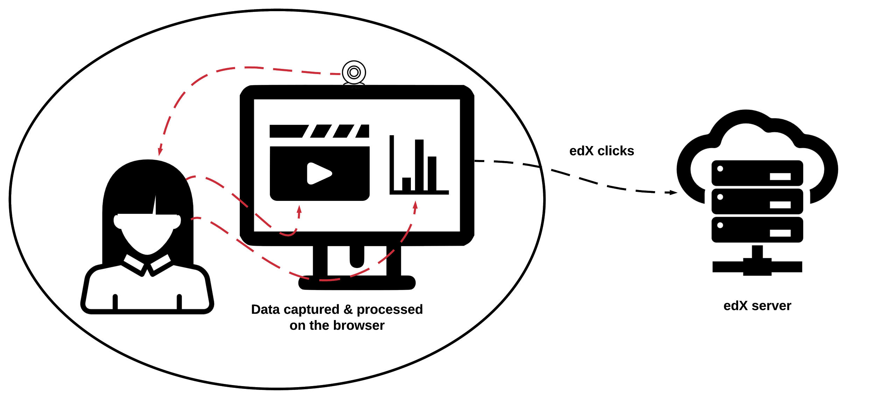

Slide 5
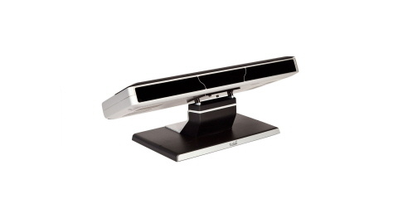



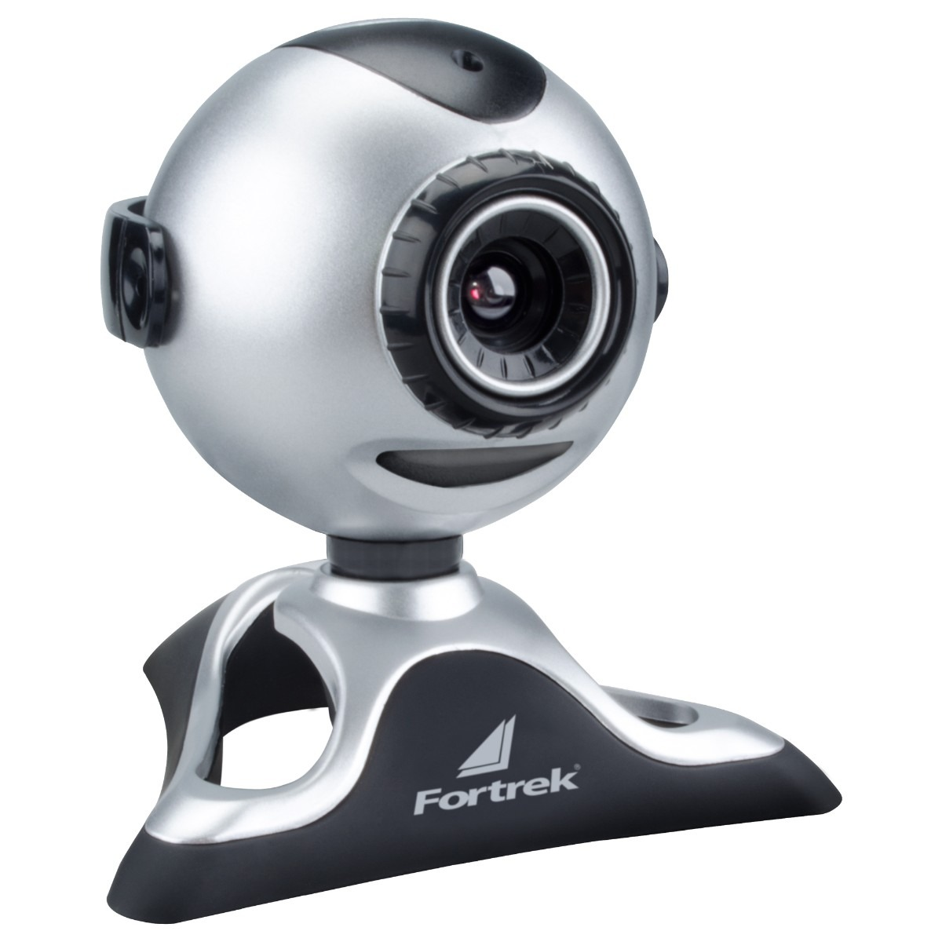
3 Research Questions
RQ1
Is browser-based eye tracking sufficiently accurate to enable tracking and detection of attention states in real-time?
RQ2
What signals are most suitable to communicate the observed attention drops to the learner (e.g. audio signals, visual signals, multi-modal)?
RQ3
Does the deployment of a real-time attention tracker positively impact MOOC learners’ engagement and performance?
Notes:
Hig-quality eyetracking vs. Web-cam based eyetracking.

Slide 6
OUR WORK
(so far)

Slide 7
3 Research Questions
RQ1
Is browser-based eye tracking sufficiently accurate to enable the tracking and detection of attention states in real-time?
RQ2
What signals are most suitable to communicate the observed attention drops to the learner (e.g. audio signals, visual signals, multi-modal)?
RQ3
Does the deployment of a real-time attention tracker positively impact MOOC learners’ engagement and performance?
80%
40%
0%
Notes:
Progress so far.

Slide 8
Our argument chain
&
study
(submitted to ECTEL)
Mind-wandering and attention lapses have been studied for a long time in the traditional classroom.
In video-heavy MOOCs mind-wandering may be even more severe due to constant temptations (emailing, chatting, etc.)
Previous research (not in a video-watching scenario though) has shown eye movements and gaze patterns to be predictive of mind-wandering.
Previous work has made use of expensive and specialized eye tracking hardware.
How well does a Webcam-based setup fare in the detection of eye movements and gaze features that are predictive of mind-wandering?
(we left out the real-time part for now)

Slide 9

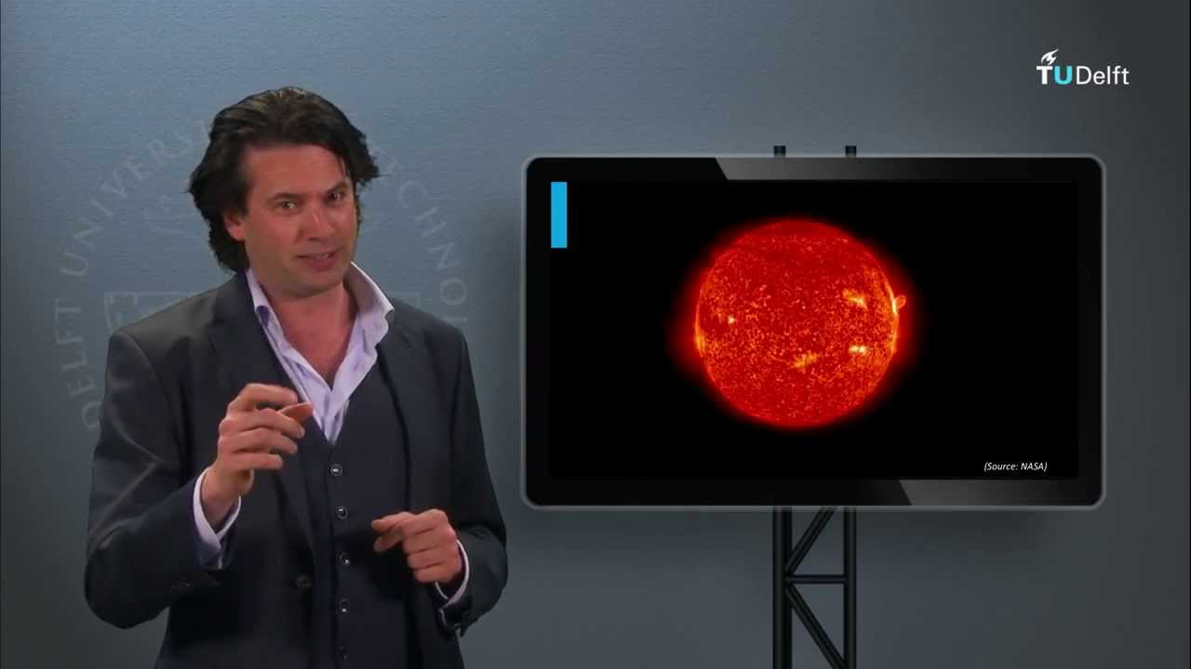
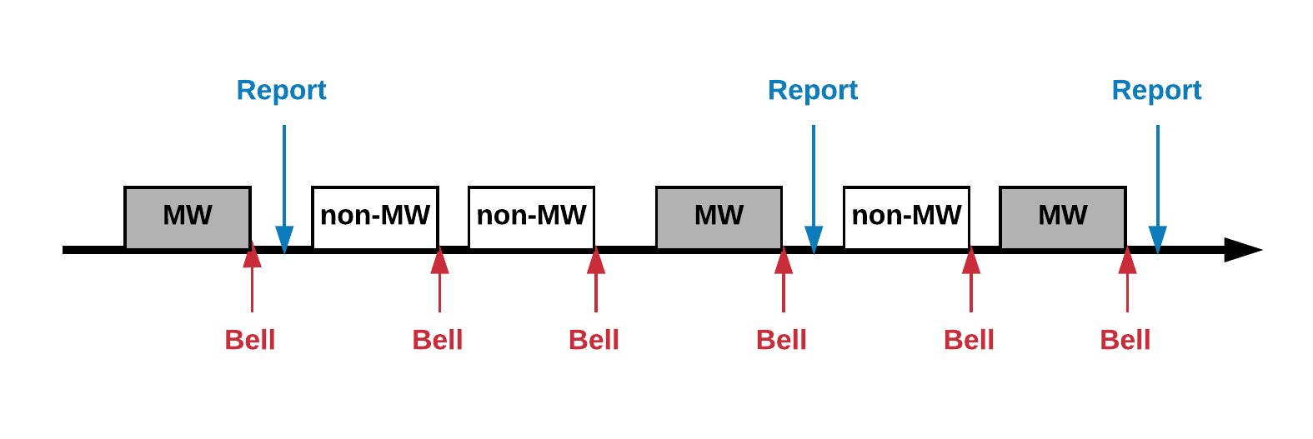
Study:
13 participants
2 MOOC videos (7-8 minutes each)
Periodic self-reports of mind-wandering
→ ground truth
Webcam and Tobii data were logged
& features extracted
→ Supervised machine learning
Were you distracted in the last 30s?

Slide 10
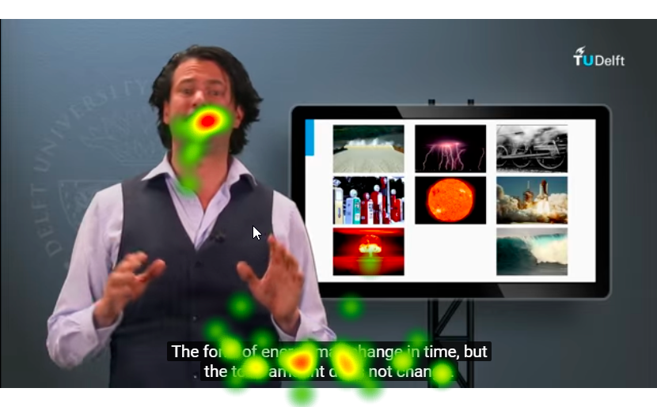
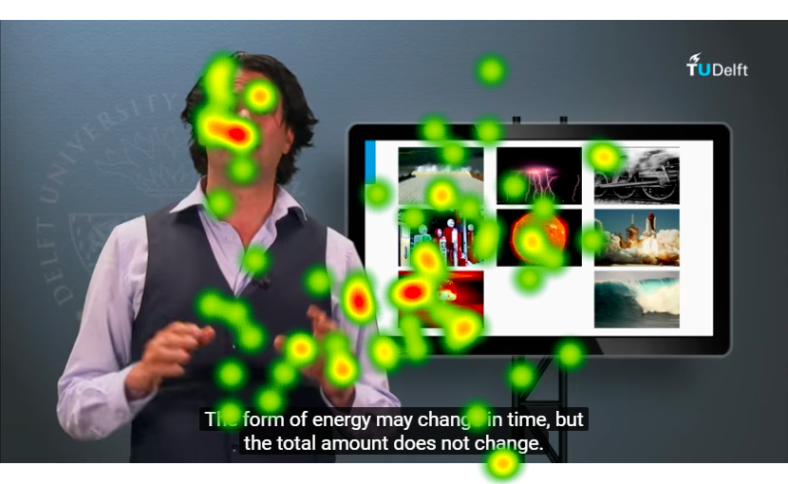
Gaze heatmaps of two participants over a 30s interval.
Reported mind-wandering.
No mind-wandering.

Slide 11
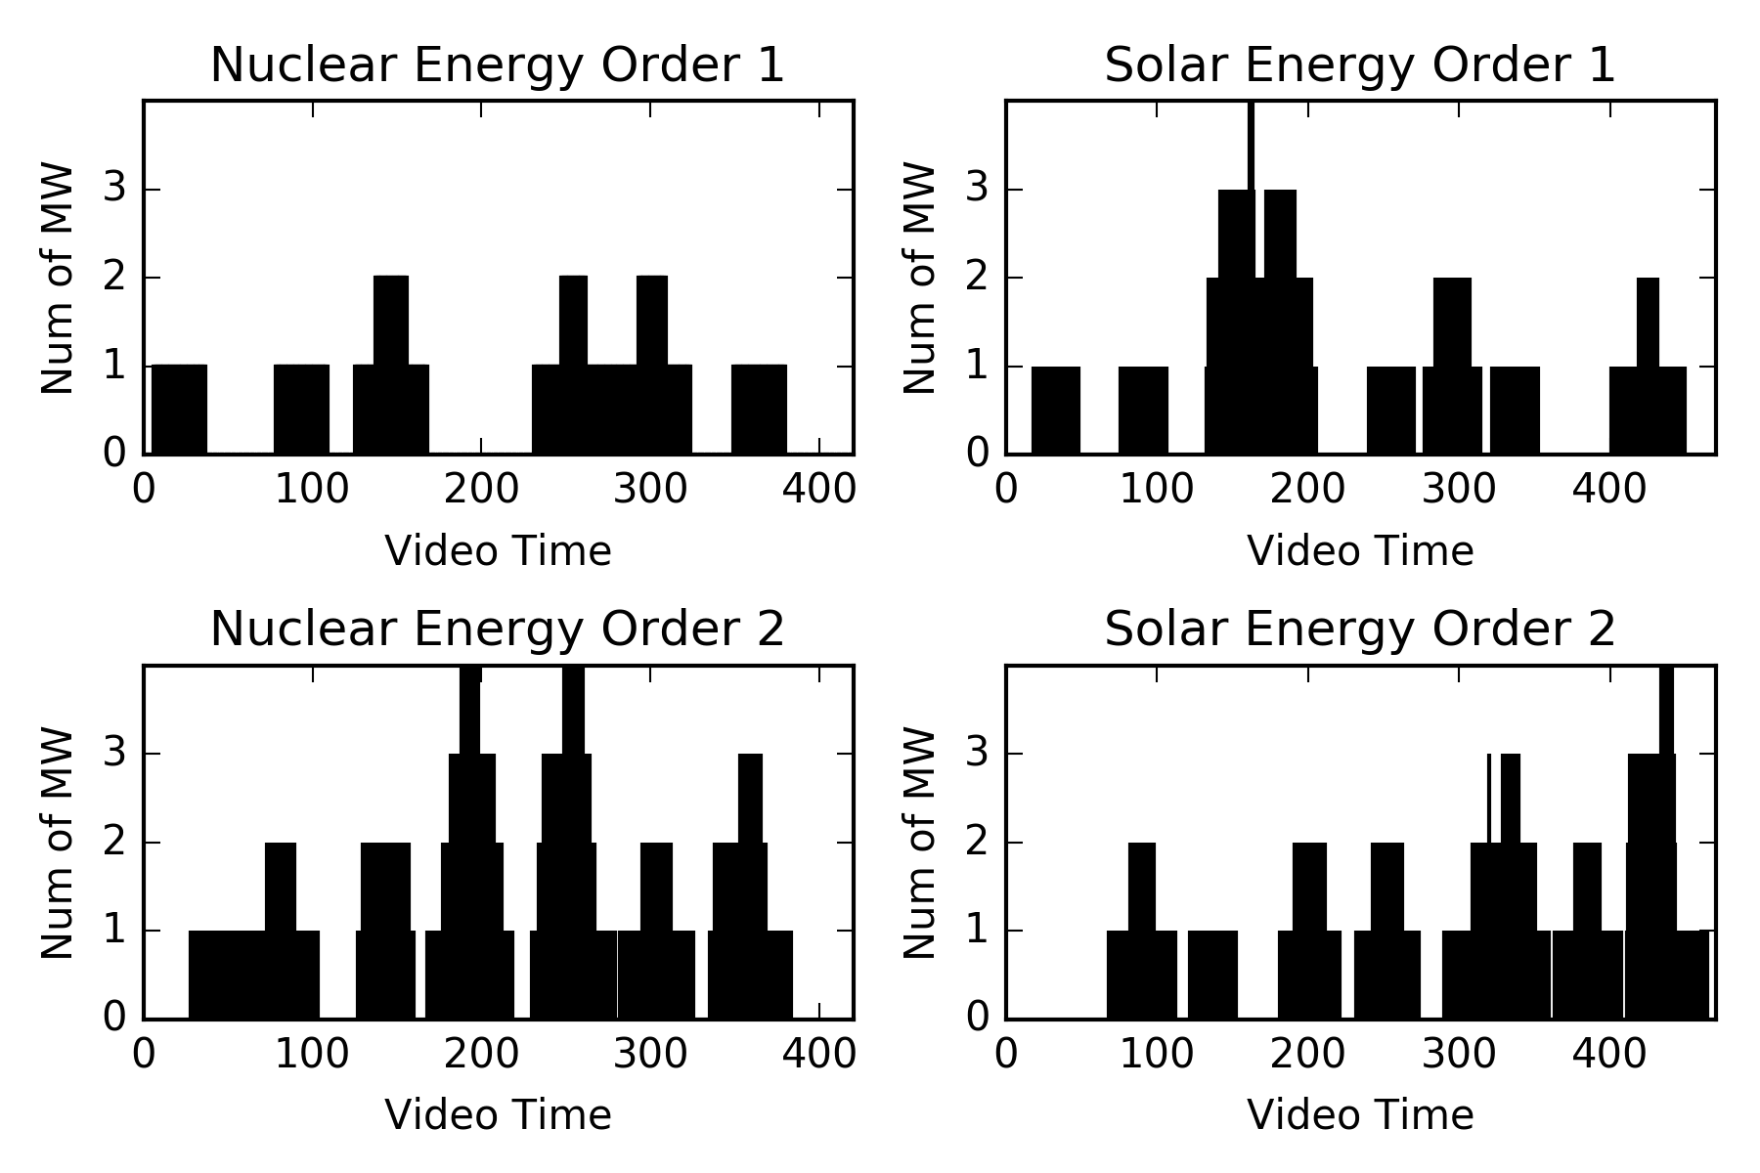
Exploratory analysis
Mind-wandering is frequent (rate of 29%), even in short videos
Participants grow tired, mind-wandering increases in the second video

Slide 12
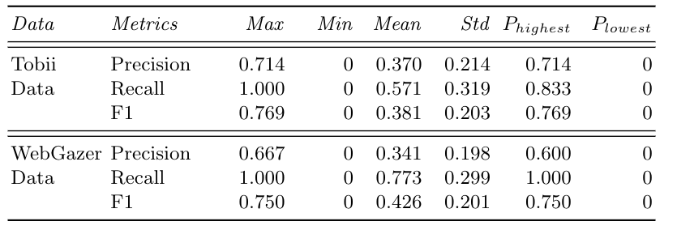
Detection results
Leave-one-out cross validation
Detectability of mind-wandering is highly user-dependent
Webcam-based data works slightly better for our purposes than the Tobii data
(we don’t yet know why)
F1 measure

Slide 13

Open issues
Our study required a calibration step - how do we get around this in a real MOOC setting?
Our trained model is optimized for features derived from 30-60 second time spans. How well does it work in a real-time setting (second to second decision)?
How can we acquire large-scale training data?

